Slide 1

Optimizing Hybrid Ferromagnetic Metal-Ferrimagnetic Insulator Spin-Hall Nano-Oscillators: a Micromagnetic Study
Robert Xi, Ya-An Lai, Haowen Ren, and Andrew D. Kent
Center for Quantum Phenomena, Department of Physics, New York University, New York, NY, 10003, USA

Slide 2
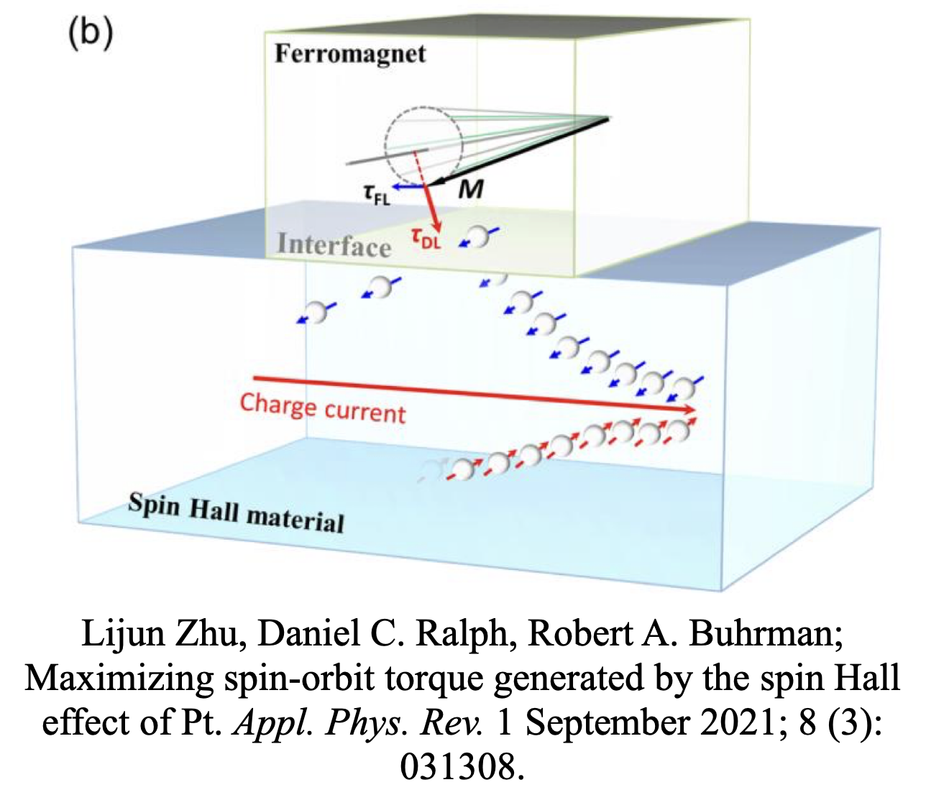

Spin Hall Nano-Oscillator (SHNO)
DC current leads to the excitation microwave frequency spin waves
2024 March Meeting | Robert Xi
1
Notes:
SHNO is a device that can convert an DC current into a microwave frequency oscillation
normally consists of two layers, a heavy metal layer and a ferromagnet layer.
when electric current passing through a heavy metal, it generates a transverse spin current due to spin hall effect.
This spin current interacts with the neighboring ferromagnet layer, causing the precession of magnetic moments, which can generates microwave-frequency oscillations.
however, this traditional bilayer design typically have high threshold currents as well as output powers.

Slide 3
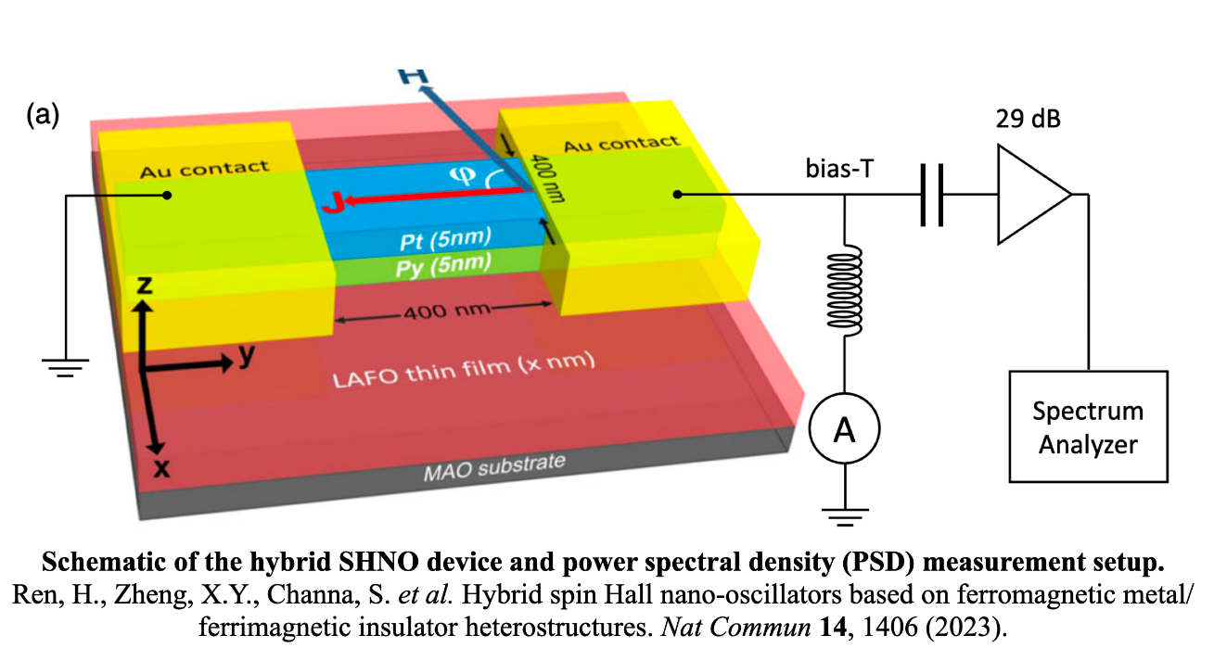
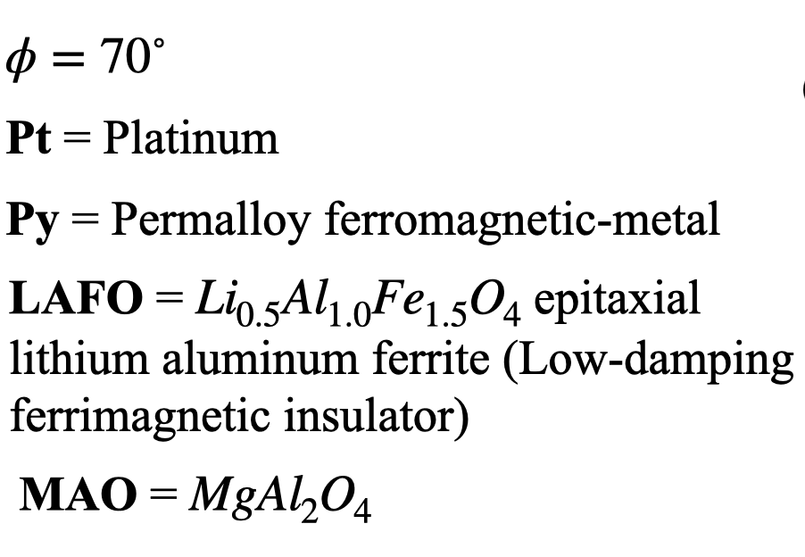
Hybrid SHNO From Previous Work
Permalloy (Py) ferromagnetic-metal nanowire and low-damping ferrimagnetic insulator (FI)
*
* Zheng, X.Y., Channa, S., Riddiford, L.J. et al. Ultra-thin lithium aluminate spinel ferrite films with perpendicular magnetic anisotropy and low damping. Nat Commun 14, 4918 (2023). https://doi.org/10.1038/s41467-023-40733-9
2024 March Meeting | Robert Xi
2
Notes:
In our previous work, we discovered that when adding an additional LAFO layer, (which is a low damping ferrimagnetic insulator), underneath the traditional SHNO, the excitations exhibit a larger output power;
this is a schematic of our hybrid SHNO, the top layer is a …, .. , by adding this LAFO, we are also allowing the hybrid SHNO to emit SW

Slide 4
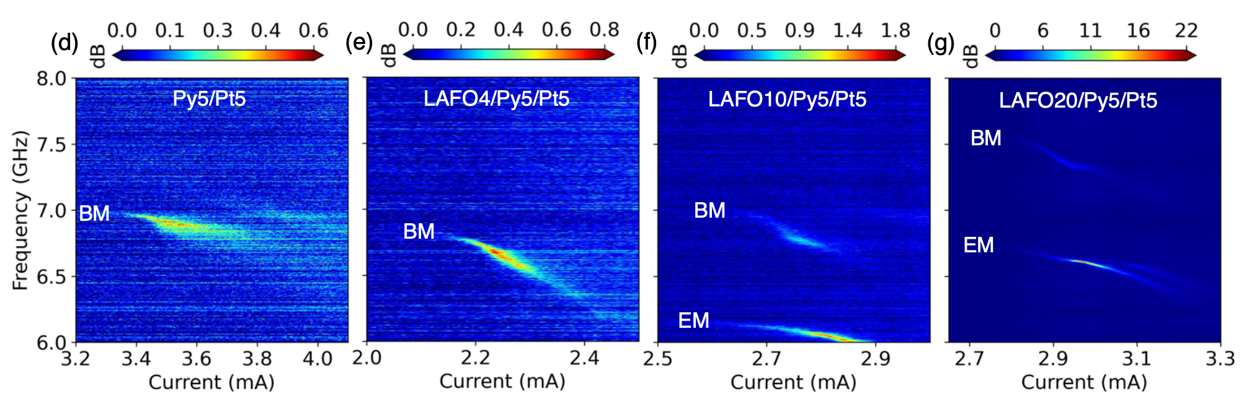
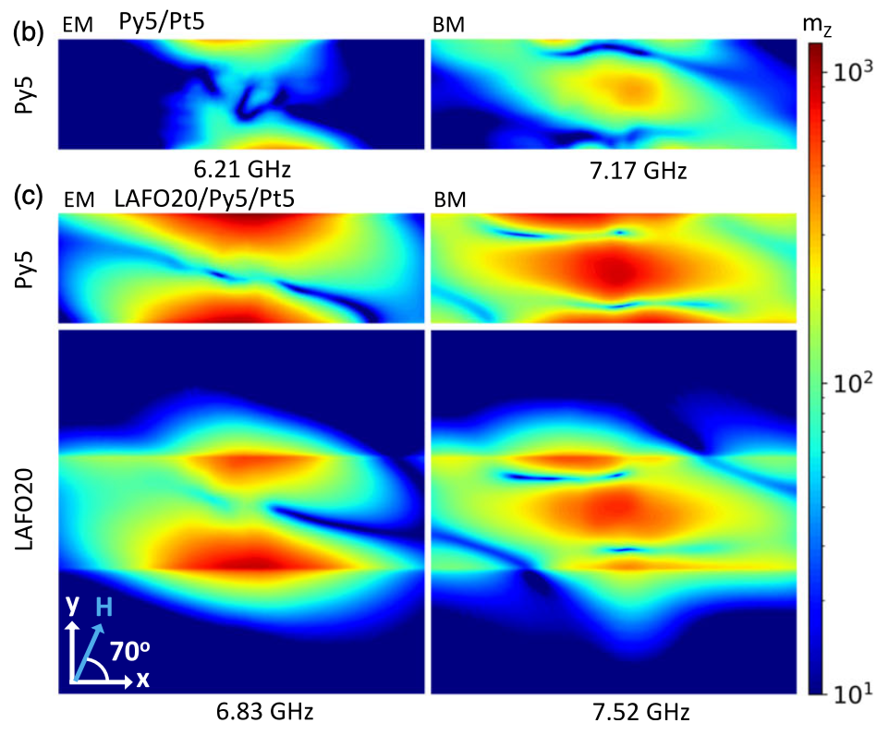
Hybrid SHNO From Previous Work
Experimental Results
Micromagnetic Modeling
EM
BM
Py5/Pt5
LAFO20/Py5/Pt5
Power spectral density (PSD) as a function of bias current at fixed field H = 0.0817 T for φ = 70˚.
J_{th} drops dramatically between Py5/Pt5 & LAFO20/Py5/Pt5
Edge Mode (EM) gradually becomes dominant
Peak amplitude & quality factor for LAFO20/Py5/Pt5 significantly higher than Py5/Pt5
Spatial FFT from simulation. Top view of spatial FFT images of Py and LAFO layers for Py5/Pt5 and LAFO20/Py5/Pt5
2024 March Meeting | Robert Xi
3
Notes:
Here’s some data from our previous work.
The four images on the left are the power-spectral-density as a function of current. From left to right, the thickness of the LAFO layer increases. Notice the scale bar changes for each image. The output power increases significantly as we increase the thickness, and the threshold current drops dramatically when adding the LAFO layer.
there are two modes associated with this device, we attribute the higher frequency mode to a BM, and the lower frequency mode to an EM.
the image on the right shows the spatial FFT of different layers at EM & BM.
The top two images are the Spatial FFT of the Py layer of the SHNO without the LAFO layer, and the bottom four images are the spatial FFT of hybrid SHNO
One can see that after adding the LAFO layer will increase in the excitation volume, so does the amplitude of both EM & BM.
a natural question to ask is what’s so special about this LAFO that when adding it to the SHNO, the output power increases? or what characteristics of the LAFO make this happen?

Slide 5
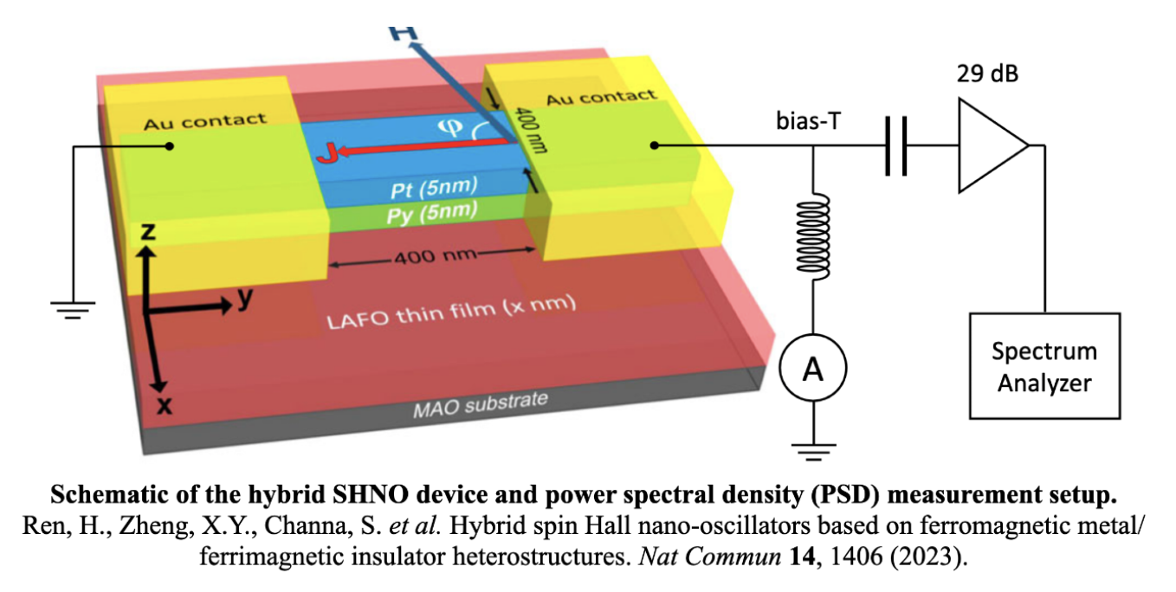
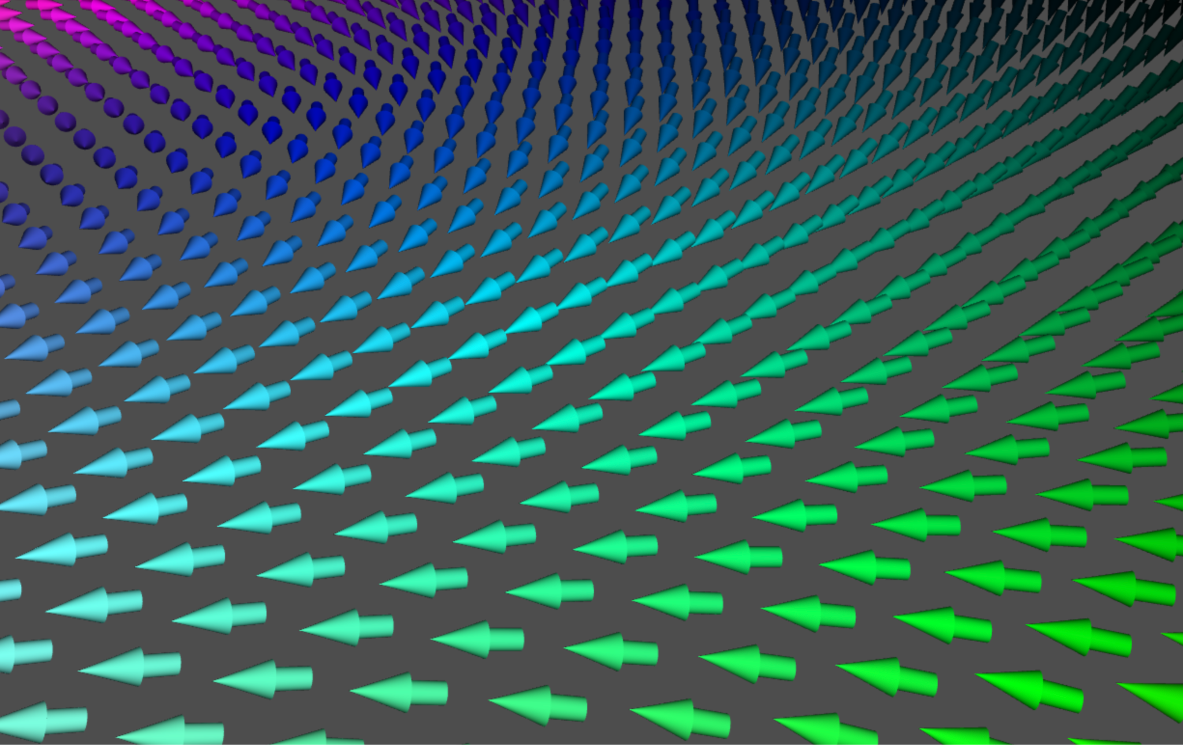
Questions
How to further enhance the power emission and quality factor of the hybrid SHNO by tuning the LAFO parameters?
How to optimize the hybrid SHNO for more advanced use cases (SHNO synchronization)?
Methods
Use micromagnetic modeling (MuMax3) to explore the relationship between the threshold current / output power and material parameters of LAFO
Explore hybrid SHNO’s behaviors by varying LAFO material characteristics, i.e. damping constant (𝛼), Saturation magnetization (M_{s}), thickness (t), perpendicular anisotropy constant (K_{u1}).
MuMax3
2024 March Meeting | Robert Xi
4
Notes:
In this research, I want to focus on two main questions: 1. 2.
we want to address those questions by using micromagnetic modeling (MuMax3) to explore the relationship between the threshold current/output power and the material parameters of LAFO. MuMax3 is a finite-difference micromagnetic simulation software used for studying the behavior of magnetic materials.
we also want to explore the hybrid SHNO behaviors by varying the material characteristics.

Slide 6
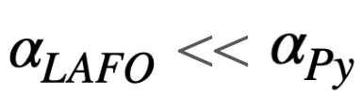
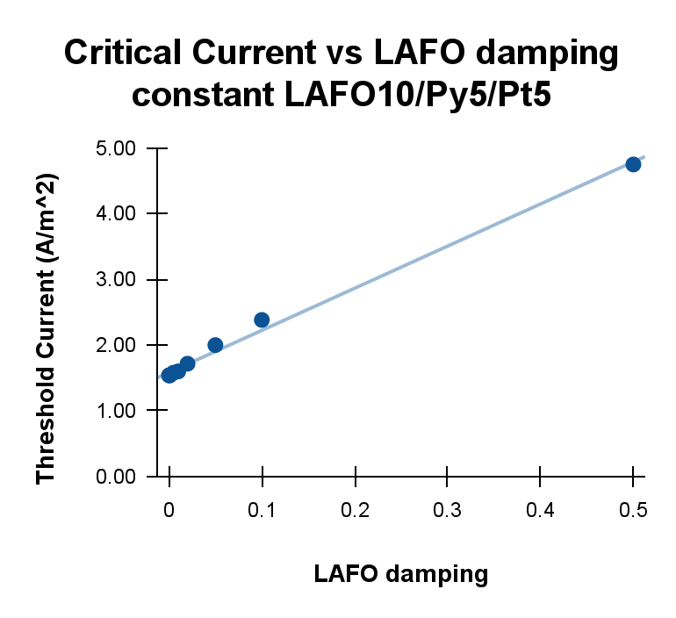
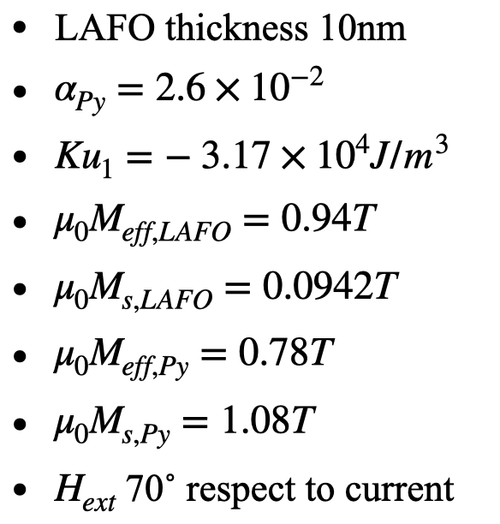
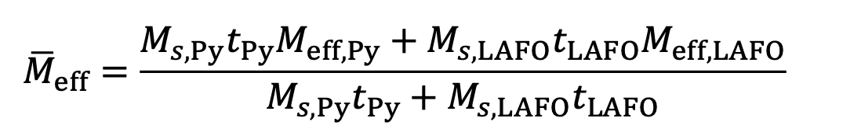
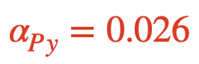
Threshold Current vs LAFO Parameters
Threshold current change with LAFO damping constant, but for , Py properties determine the threshold current
Threshold current slightly increases as the LAFO thickness increases
Threshold current does not depend strongly on the LAFO saturation magnetization and exchange coupling between the LAFO and Py
Constants:
Two Coupled Macrospin Model:
2024 March Meeting | Robert Xi
5
Notes:
We first vary different LAFO parameters to see their impact on the threshold current.
we found that there’s a linear relationship between the threshold current and LAFO damping constant, as shown in this diagram, but for the damping constant of LAFO much less than that of the permalloy, which is almost always the case, the threshold current is mostly determined by Py’s properties.
we also found that the threshold current doesn’t depend strongly on the LAFO thickness, Ms & exchange coupling constant.
Those results are consistent with our macrospin model, which states that the threshold current depends on the damping, Ms, the thickness of Py and LAFO, and because Ms and damping of Py are much larger than that of the LAFO, the threshold current mostly depends on the properties of Py.
(For example, according to the theory, when changing LAFO thickness from 5nm to 40nm, the threshold current will change by only 2.6%; which is consistent with our findings. )
according to the theory,
when changing the LAFO damping constant, the ratio of slope/y-intercept from data = 6.41/1.58 = 4.057; the ratio from theory = 6.7;
when changing LAFO µ0Ms from 0.08 to 0.3 T (thickness = 10nm, alpha=10^-3), critical current will change by only 1.5%;
when changing thickness from 0 to 40nm, (LAFO µ0Ms=0.0942T, alpha=10^-3), critical current will change by only 2.6%.

Slide 7
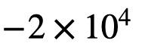
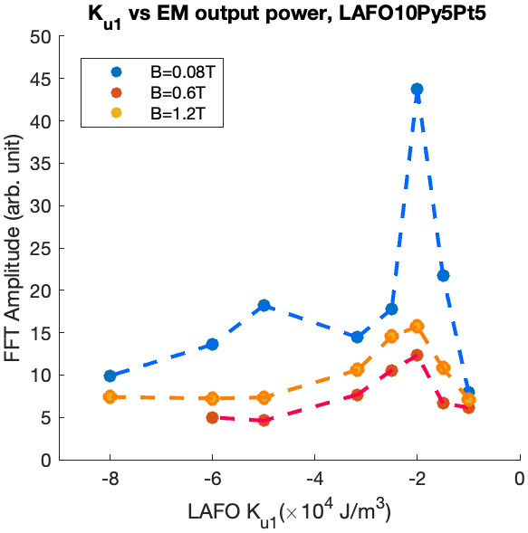
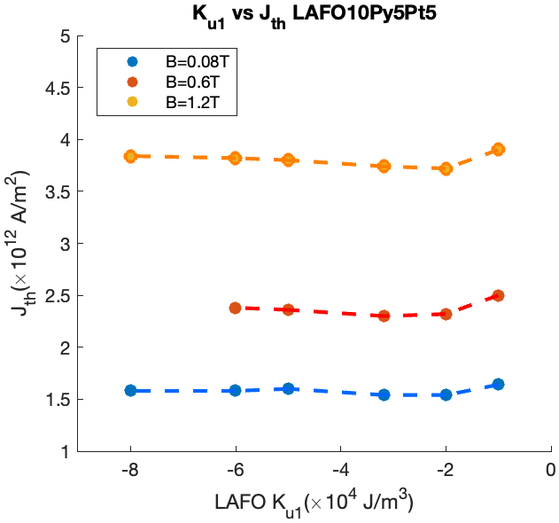
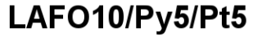
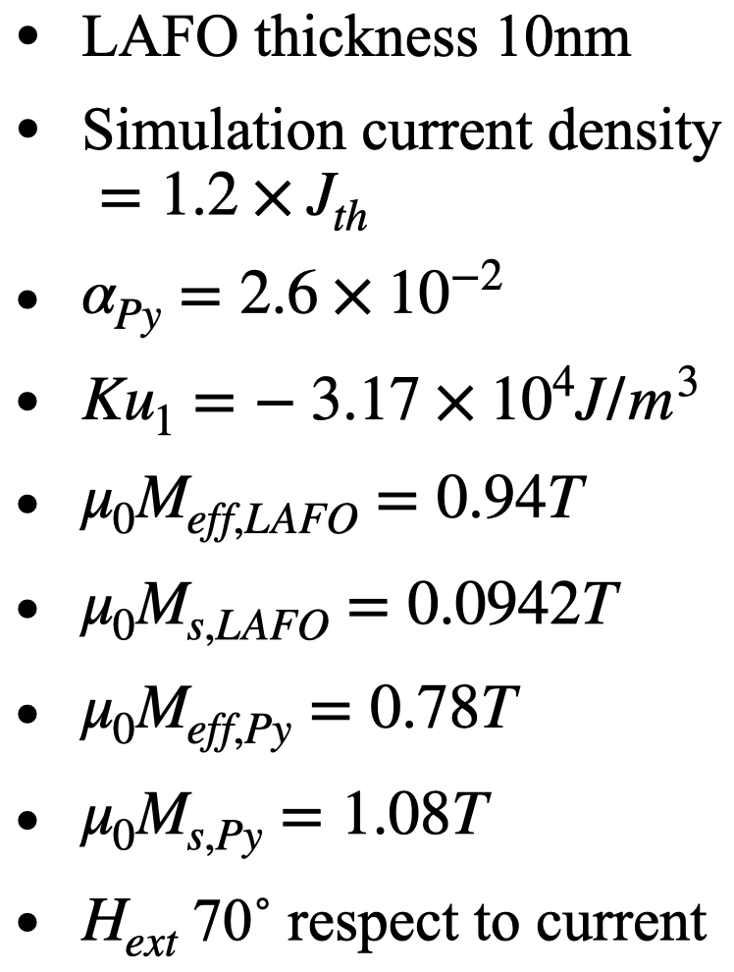
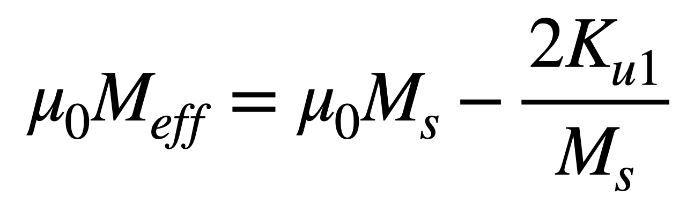
Output power vs LAFO Parameters
4. A maximum EM output power is observed when the LAFO perpendicular anisotropy constant (K_{u1}) is around J/m³ (note: K_{u1}< 0 is an easy plane anisotropy)
Constants:
Critical current density as a function of LAFO K_{u1}.
Spatial averaged FFT amplitude of the z-component magnetization in the Py layer as a function of LAFO K_{u1}.
2024 March Meeting | Robert Xi
6
Notes:
we further investigated the effect of the perpendicular anisotropy constant of LAFO (Ku1) on the threshold current and the output power. negative Ku1 means easy axis is in-plane.
Still, the threshold current doesn’t seems to be strongly affected by the Ku1. However, we saw an peak of the EM output power when Ku1 is around -20 kilojoules per meter cubed.
we were curious about the nature of this behavior, so
(Notice that for each simulation, we set the current density to be 1.2 times the threshold current density, so that we can make sure that variation of the output power is not caused by the variation in the critical current density.)

Slide 8
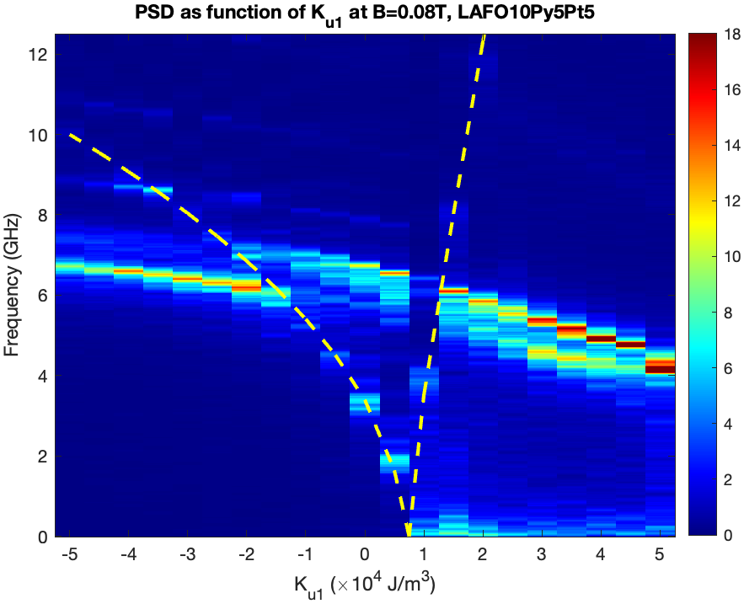
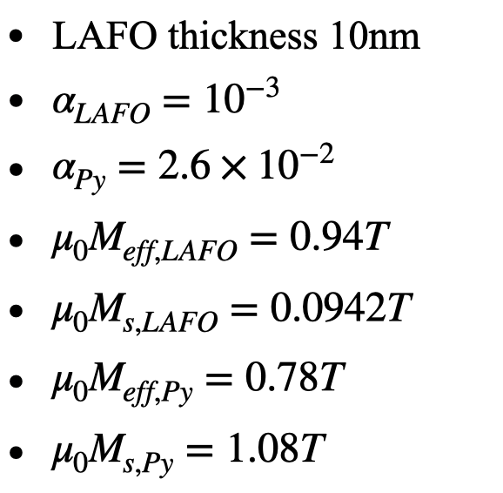
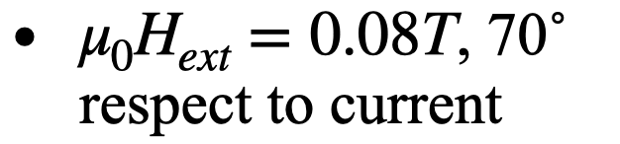
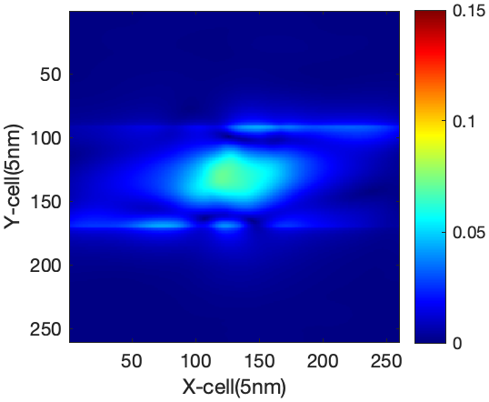
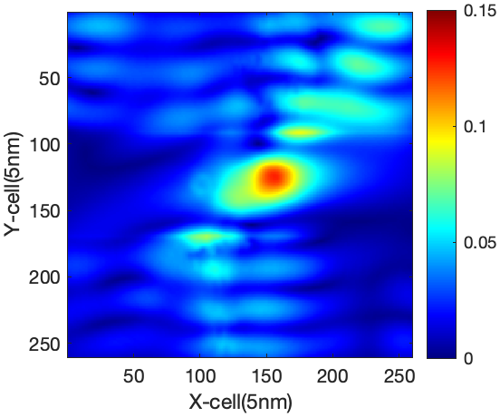
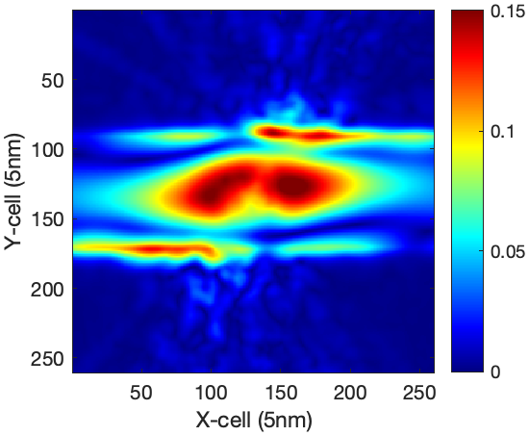
II. Localized Mode & Propagating Spin Wave Controlled By K_{u1}
– – – FMR
Constants:
Propagating mode
FMR frequency > Bulk Mode frequency: Localized Mode
FMR frequency < Bulk Mode frequency: Propagating Mode
Localized mode
BM/EM
BM
Localized mode
EM
Spatial FFT images of LAFO layer obtained at BM resonance:
K_{u1}= -3.17⨉10⁴ J/m³
K_{u1}= -1⨉10⁴ J/m³
K_{u1}= +1.5⨉10⁴ J/m³
2024 March Meeting | Robert Xi
7
Notes:
So we made a power spectrum density map as function of Ku1( vary from -50 to +50 kilojoules per meter cubed, the constants are listed on the right.)
The yellow dash line is the FMR frequency.
As the Ku1 increases, the EM amplitude increases and the frequency drops. we observed that the peak of the EM output power is when its frequency coincides with the FMR frequency. However, as the Ku1 further increased, the output power of EM drops drastically and then disappear,(explanations?).
we also found some interesting behavior of the BM:
the output power of BM keeps increasing as the Ku1.
when the FMR freq is higher than BM freq, the mode is localized
When the FMR freq is smaller than the BM freq, we observed a propagating mode, as illustrated in the bottom spatial FFT images of LAFO layer.

Slide 9
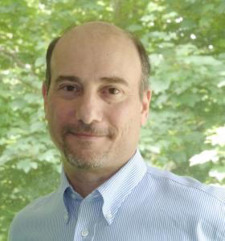



Conclusion
The threshold current does not depend strongly on the LAFO parameters.
Observed an increase in EM amplitude when the EM frequency coincides with the FMR frequency
Observed a change from localized modes to propagating modes for hybrid SHNO BM when varying K_{u1}:
FMR frequency > Bulk mode frequency: Localized Modes
FMR frequency < Bulk mode frequency: Propagating Modes
Propagating modes can provides means of synchronizing multiples SHNO
This research was supported by NSF Award DMR-2105114.
Prof. Andrew D. Kent
Ya-An Lai
Haowen Ren
2024 March Meeting | Robert Xi
8
Notes:
Here’s our conclusion for this research:
The threshold current does not depend strongly on the LAFO parameters, such as thickness and damping constant.
we found we can increase the EM amplitude by varying Ku1 to make the EM frequency coincides with FMR frequency
we observed a change from localized modes to propagating modes for device’s BM when varying Ku1. To be specific, when FMR freq > BM freq, BM is localized; when FMR freq< BM freq, BM is propagating mode,
those information may help us to build SHNO synchronization in the future.

Slide 11
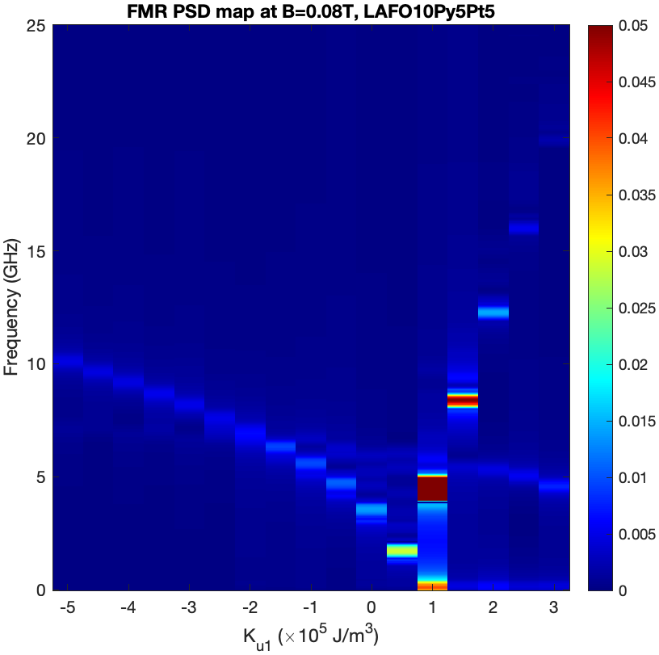
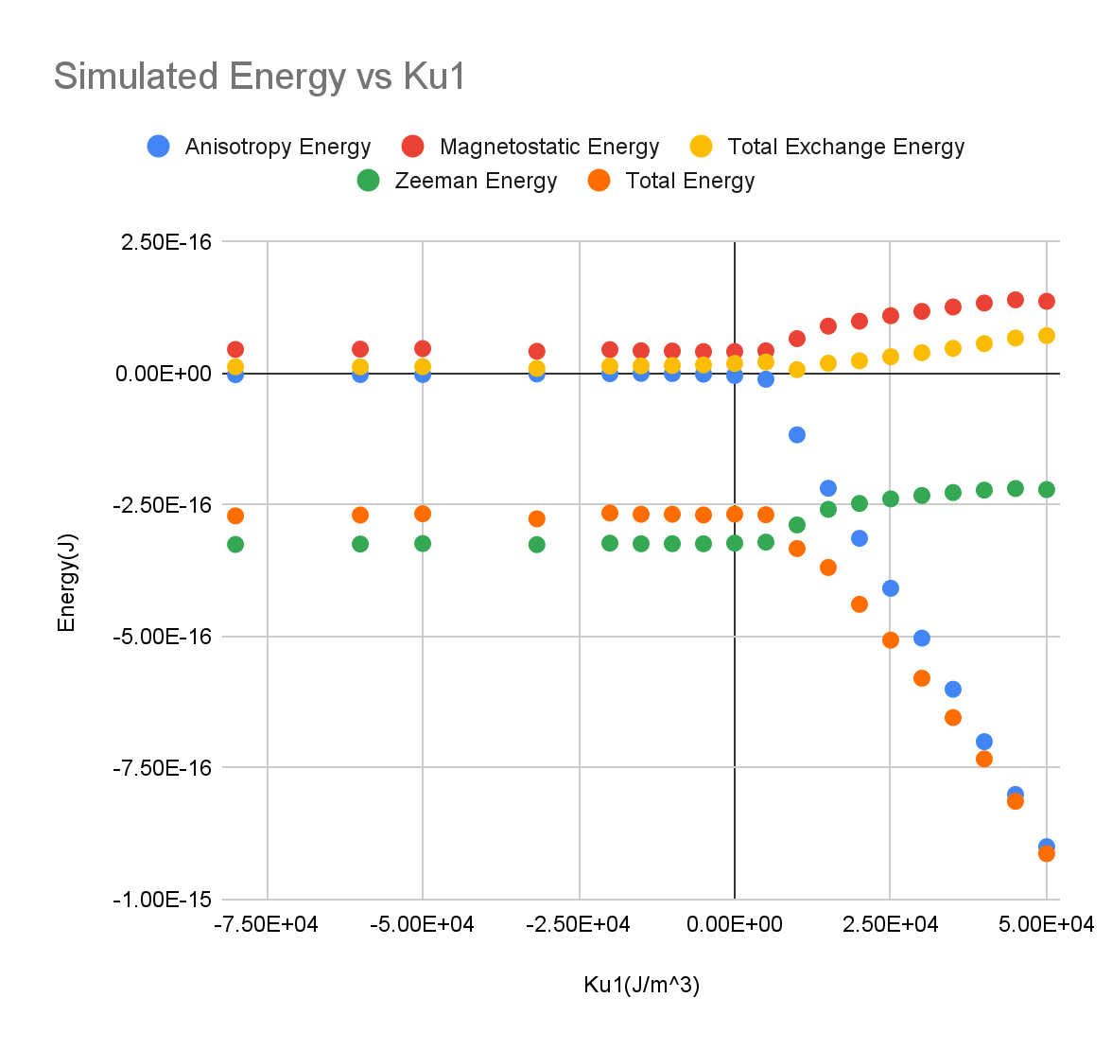
Supplementary
FMR PSD map & energy terms as function of Ku1
2024 March Meeting | Robert Xi

Slide 12
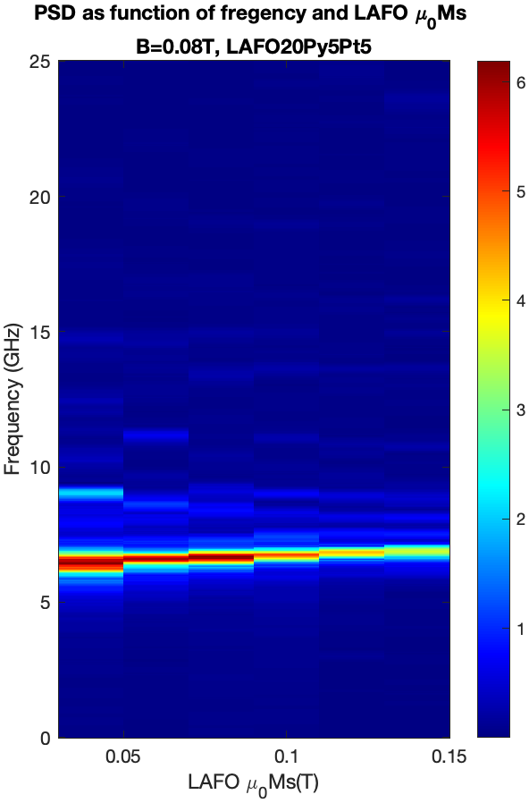
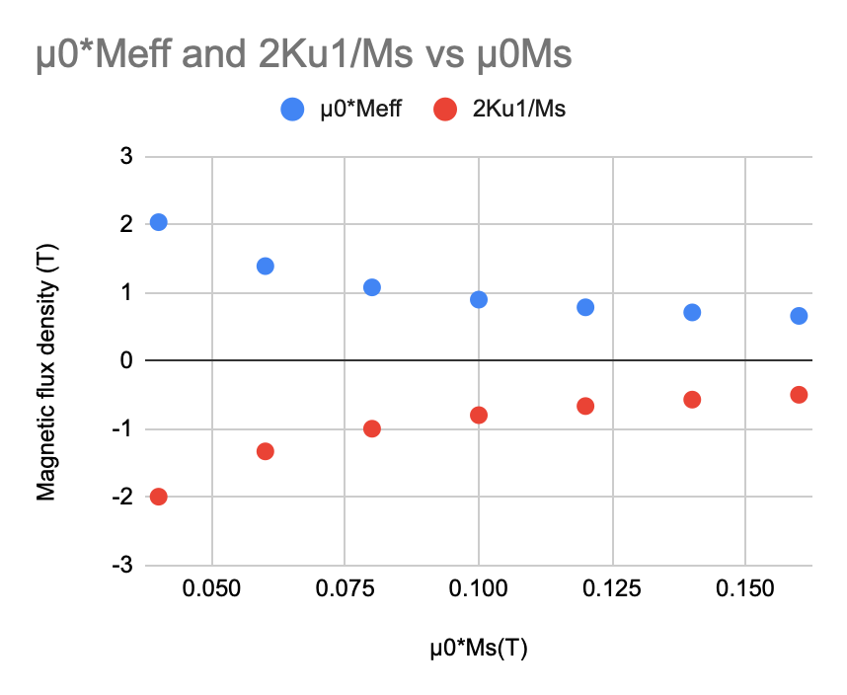
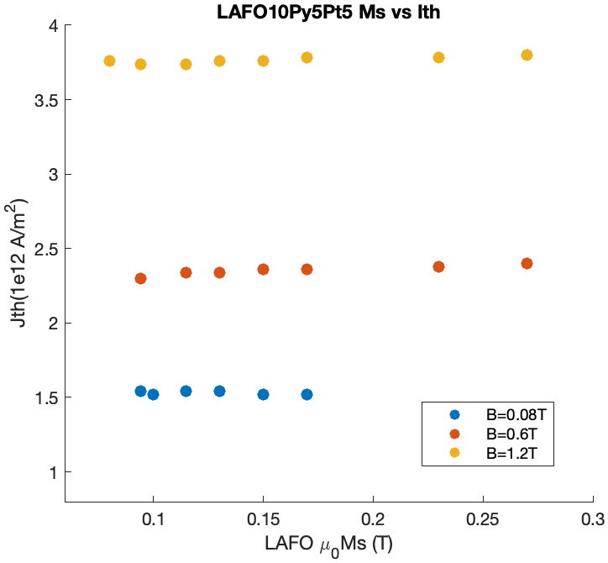
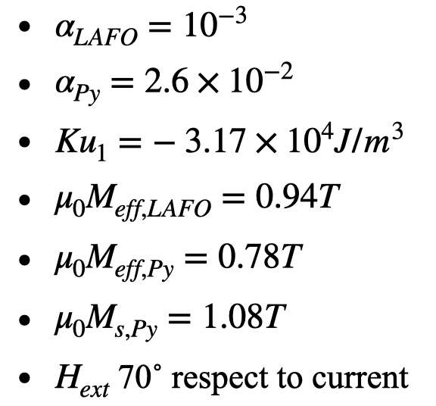
Supplementary
Critical Current vs LAFO Saturation Magnetization Ms
2024 March Meeting | Robert Xi

Slide 13
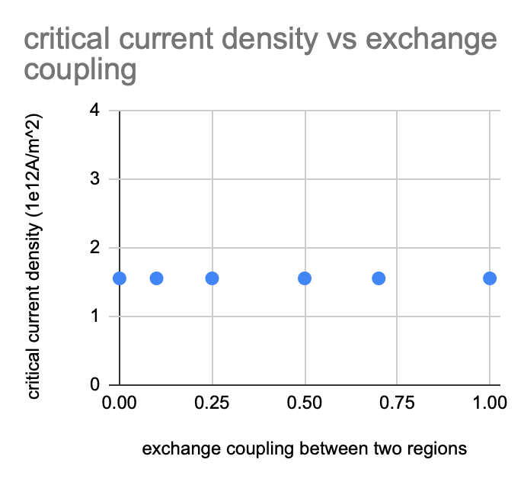
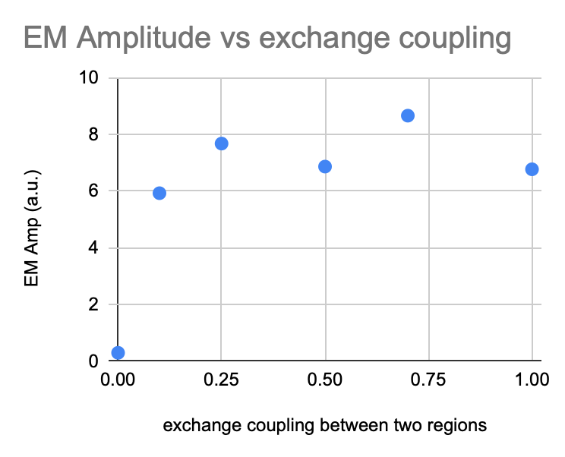
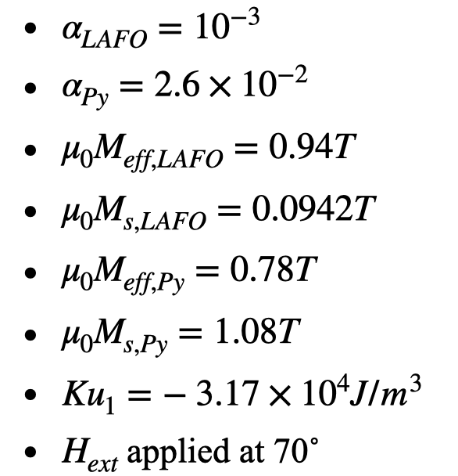
Supplementary
Critical Current vs Exchange Coupling Constant
2024 March Meeting | Robert Xi

Slide 14
Supplementary
Critical Current vs LAFO Saturation Magnetization Ms
2024 March Meeting | Robert Xi

